Slide 1
RainOpsRevolution: Enhancing Heavy Machinery Performance in Wet Conditions in Deep Mines
TEAM MEMBERS-DEEPANSH GOEL ARYAN SETHI KARTIK BISHT K RACHIT KUMAR

Slide 2
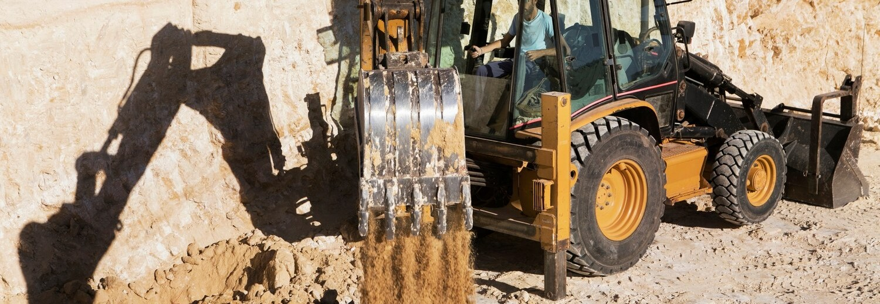
In this presentation, we will explore strategies for maximizing efﬁciency and minimizing losses in heavy earth moving machinery during rainy seasons. We will address the operational challenges and provide practical solutions for the industry.

Slide 3
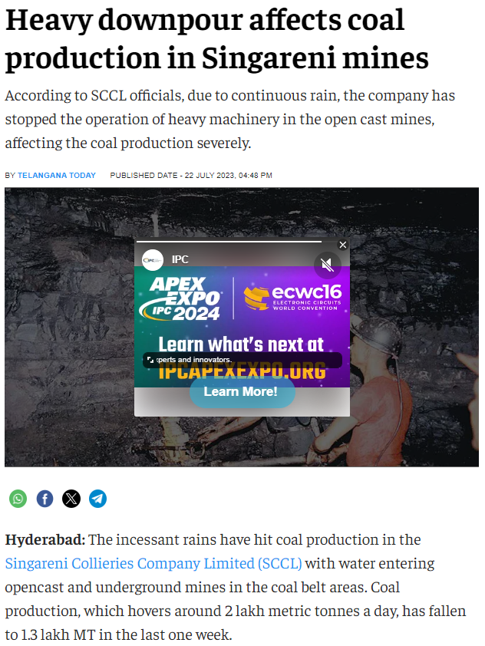
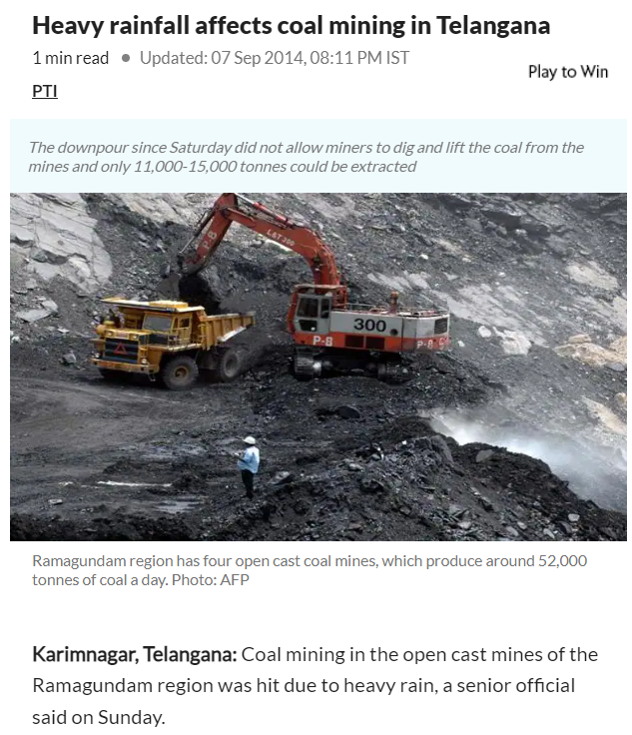
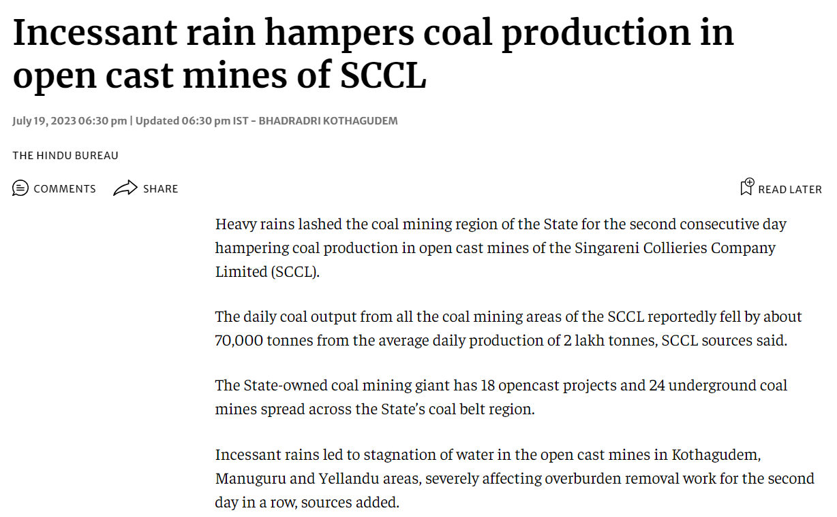
How Rainfall Affects Coal Production
Time and again India’s top coal-producing states like Maharashtra, West Bengal, Chattisgarh, Telangana, Odisha and Jharkhand witness heavy losses in their coal production which affects India’s overall energy needs. Coal is the most important fossil fuel and fulfils almost 55% of India’s energy needs.

Slide 4
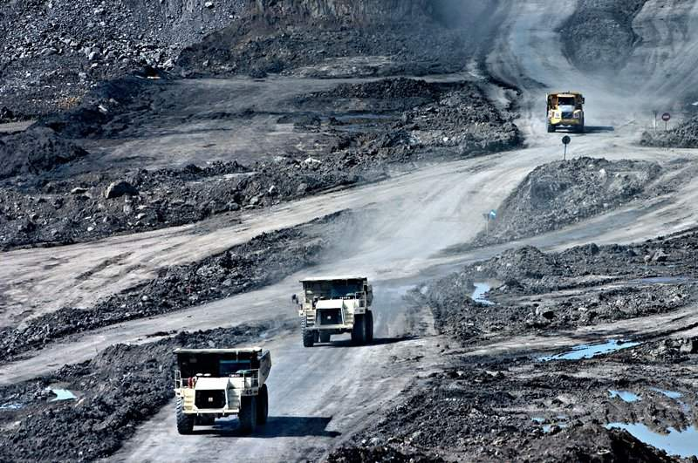
Navigating Rainfall Challenges: The Economic Impact on Coal Production
Several reports from 2014 to the present year can be found in the public domain which show how Singareni Collieries Company Ltd. open cast mines suffered losses every year during the monsoon season. An average loss of 40K tons of coal. This monetarily is equivalent to a loss of 18-20 Crore rupees. The issue is recurring and it’s still unfixed, because of this mine operators in the fields of Karimnagar and Kothagudem ignore the 35-40 days of monsoon every year. This is done to reduce the maintenance cost that will go into the repairs of heavy machinery damaged on the treacherous paths of coal mines.

Slide 5
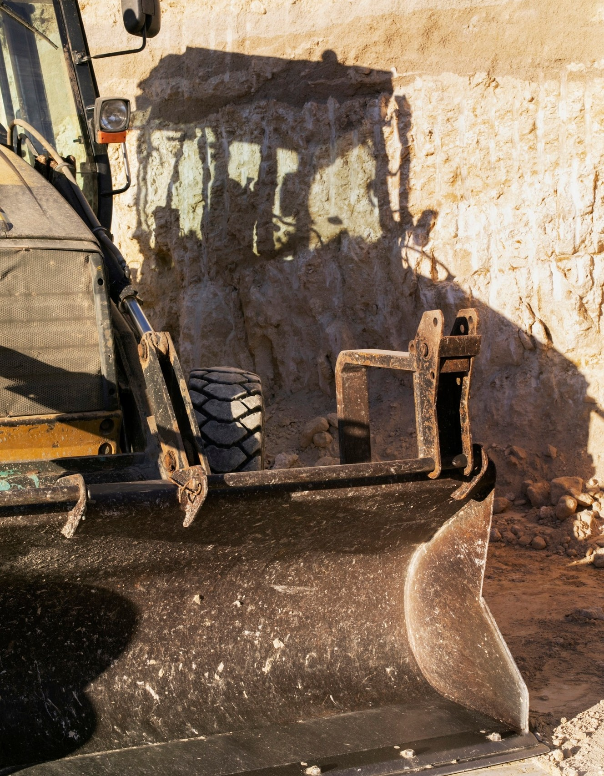
Understanding Rainy Season Challenges
During rainy seasons, heavy machinery faces increased risks of slipping, stalling, and corrosion. The excessive moisture can lead to reduced productivity and increased maintenance costs. It is crucial to address these challenges effectively.That’s why we have come with a miniature model of mines and have developed solution that resolves the issues faced by the drivers in the mines.

Slide 6
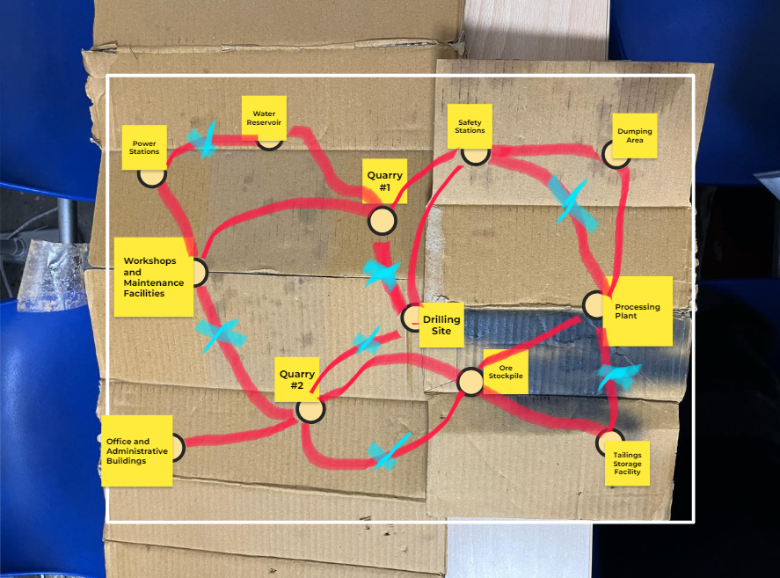
Miniaturized Coal Mine Map

Slide 7
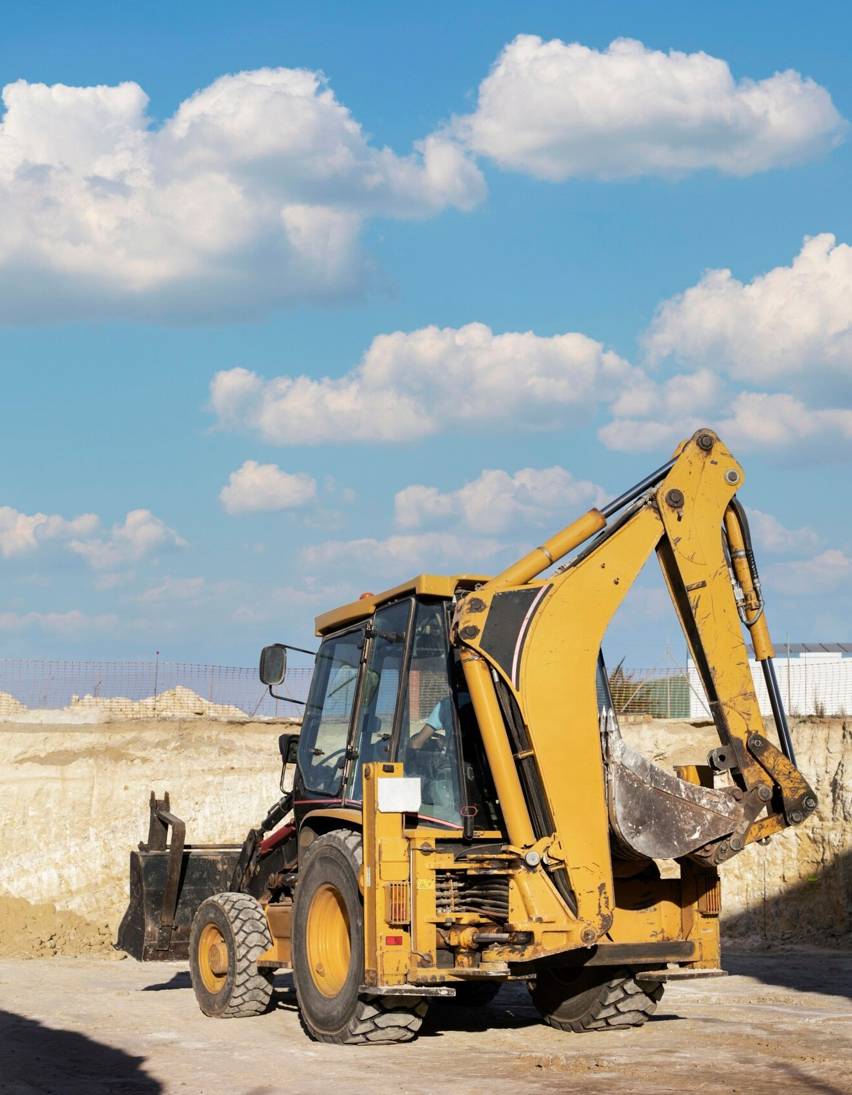
In the Miniaturized model
We have used ESP32 to operate LEDs and communicated the data over wifi. Integrating these with a web-based GUI will create a smooth interface for drivers.

Slide 8
Installation Procedure in Mines
Specialist map designer will take the help of blueprints and visits to the mine to develop a terrain map. The system administrators will provide the regular moving paths and rainfall blockage data. The terrain and water pits can be scanned using two methods:
A) Aerial Drone Scanning
B) Commercial Water Level Indicators
We will discuss their usage in further slides

Slide 9
Installation Procedure in Mines
2) The Terrain Map will consist of the following parts
- Nodes (Locations such as Drilling Sites, Quarries, Buildings, etc.)
- Available Paths (The terrain routes where the machineries operate)
- Blockage Sites (The sites where rainwater potentially obstructs the pathways)

Slide 10
Installation Procedure in Mines
3) Red coloured floodlights will be installed on the given paths on the terrain
4) Installation of Software on Admin and Operator Systems (And provide computers if not available already)
5) Installation of local network lines for communication throughout the mines even in extreme weather conditions

Slide 11
WORKING OF THE PROJECT
The weather conditions will be actively updated on the software
If the weather is rainy OR foggy, the path finding systems will be activated
In cases of rain, we use the given scanners to detect the water blockages, and the algorithm will scan the shortest optimal path to the target location through the widely used Djkistra’s Algorithm.

Slide 12
WORKING OF THE PROJECT
4) The GUI applications will be updated on both administrator and the operators screen.
5) The maps will act like a GPS on both screens, and the floodlights will be activated to indicate the correct paths in foggy conditions to prevent any accidents.

Slide 13
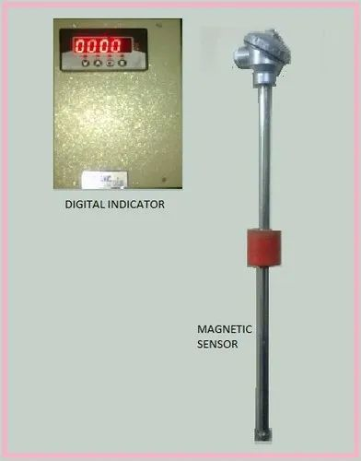
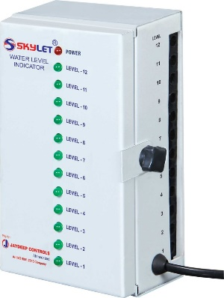
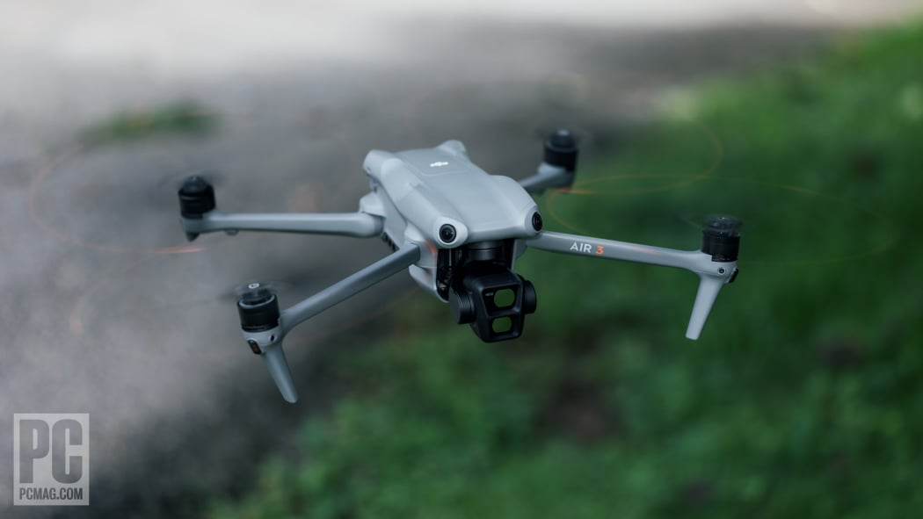
OUR PROPOSED SCANNING METHODS
FOR LARGER MINES
: Aerial Perception Drones
(Higher Cost, Better Results)
FOR AVERAGE SIZED MINES
: Commercial Grade Water Level Sensors
(Lower Cost, Robust Results)

Slide 14
Use of Drones
In larger well built mines, you cannot predefine the potential water blockage stops. But thanks to the state-of-the-art computer vision algorithms, if we have a good amount of well labelled data, we can generate terrain maps in simulations with custom paths, and use the path finding algorithms accordingly.
A good suggestion is to use Vision Transformers since they are better at generalising with less data [EXPLAIN ViTs HERE]
Generating the data for mines is a challenge on its own, that we need to solve as well.
FOR LARGER MINES
: Aerial Perception Drones Waterproof
(Higher Cost, Better Results)

Slide 15
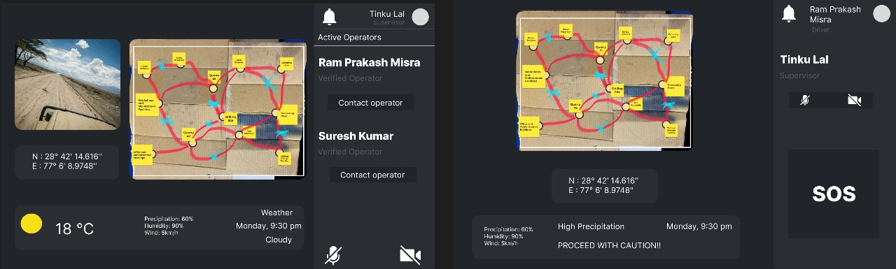
Smart Navigation System for Admins and Operators in Mines
Administrator UI
Operator UI

Slide 16
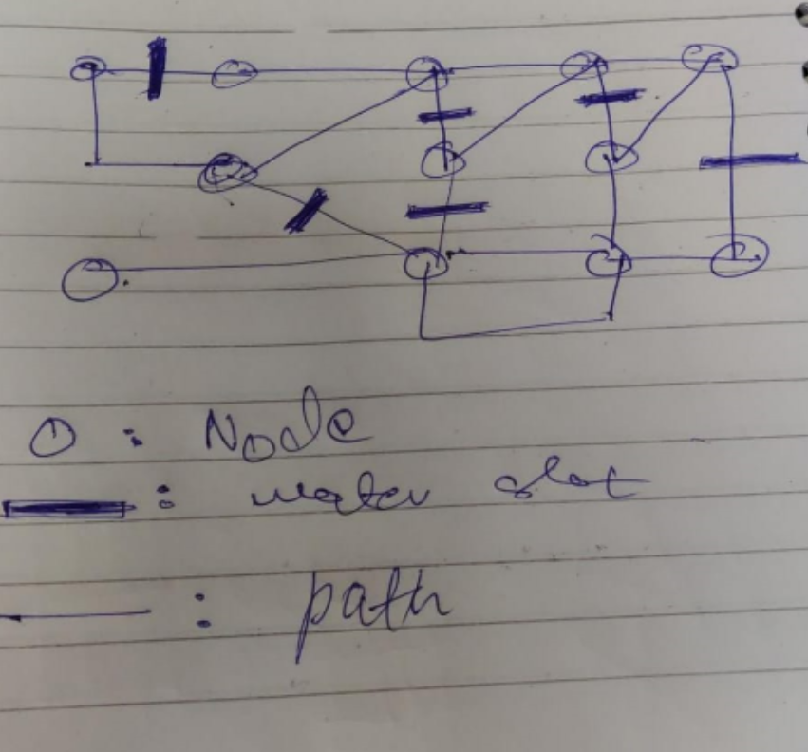
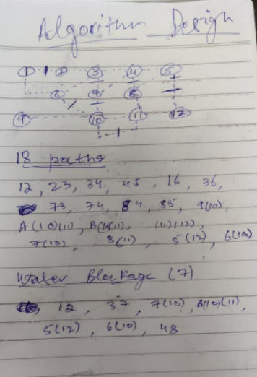
ALGORITHM DESIGN

Slide 17

Employee Training
In case of the drone aerial scanning method, the employees shall go through a one-week training and two-week practitioner tenure to operate the drone hardware and qualify as aerial perception operator.
The machinery operators and administrators shall be given a three-day course training to operate the user-friendly web application.

Slide 18
Engineering Cost
COMPONENTS-
1) Squad Pixel ESP-32 - ₹500- ₹600
2) Floodlights(15W) - ₹5500- ₹6000 per piece 3) Commercial Grade - ₹15k per pothole
Camera equipped drone - ₹50k - ₹1 L [Aerial Detection]
Processing Equipment – ₹25k
Installation and Training Costs - ₹50k and above [Depends upon mine area]

Slide 19
You might wonder, why just focus on rains?
In coal mines, the machinery is specifically designed to operate of rough paths, carry huge loads, and are powerful enough to travel on steep and rugged terrain
Feeling confused yet? Here’s a simple analogy:
Just like how due to weather and visibility conditions, there are very efficient implementations in flight operations, such as flight operators, towers, warning lights, landing assistants, we want to create such a system for coal mines.
Sounds weird right?
This is a very understated problem, and indirectly influences our daily life. Even if it is a small solution, it will definitely compound over the next few years, just like investing long term.

Slide 20
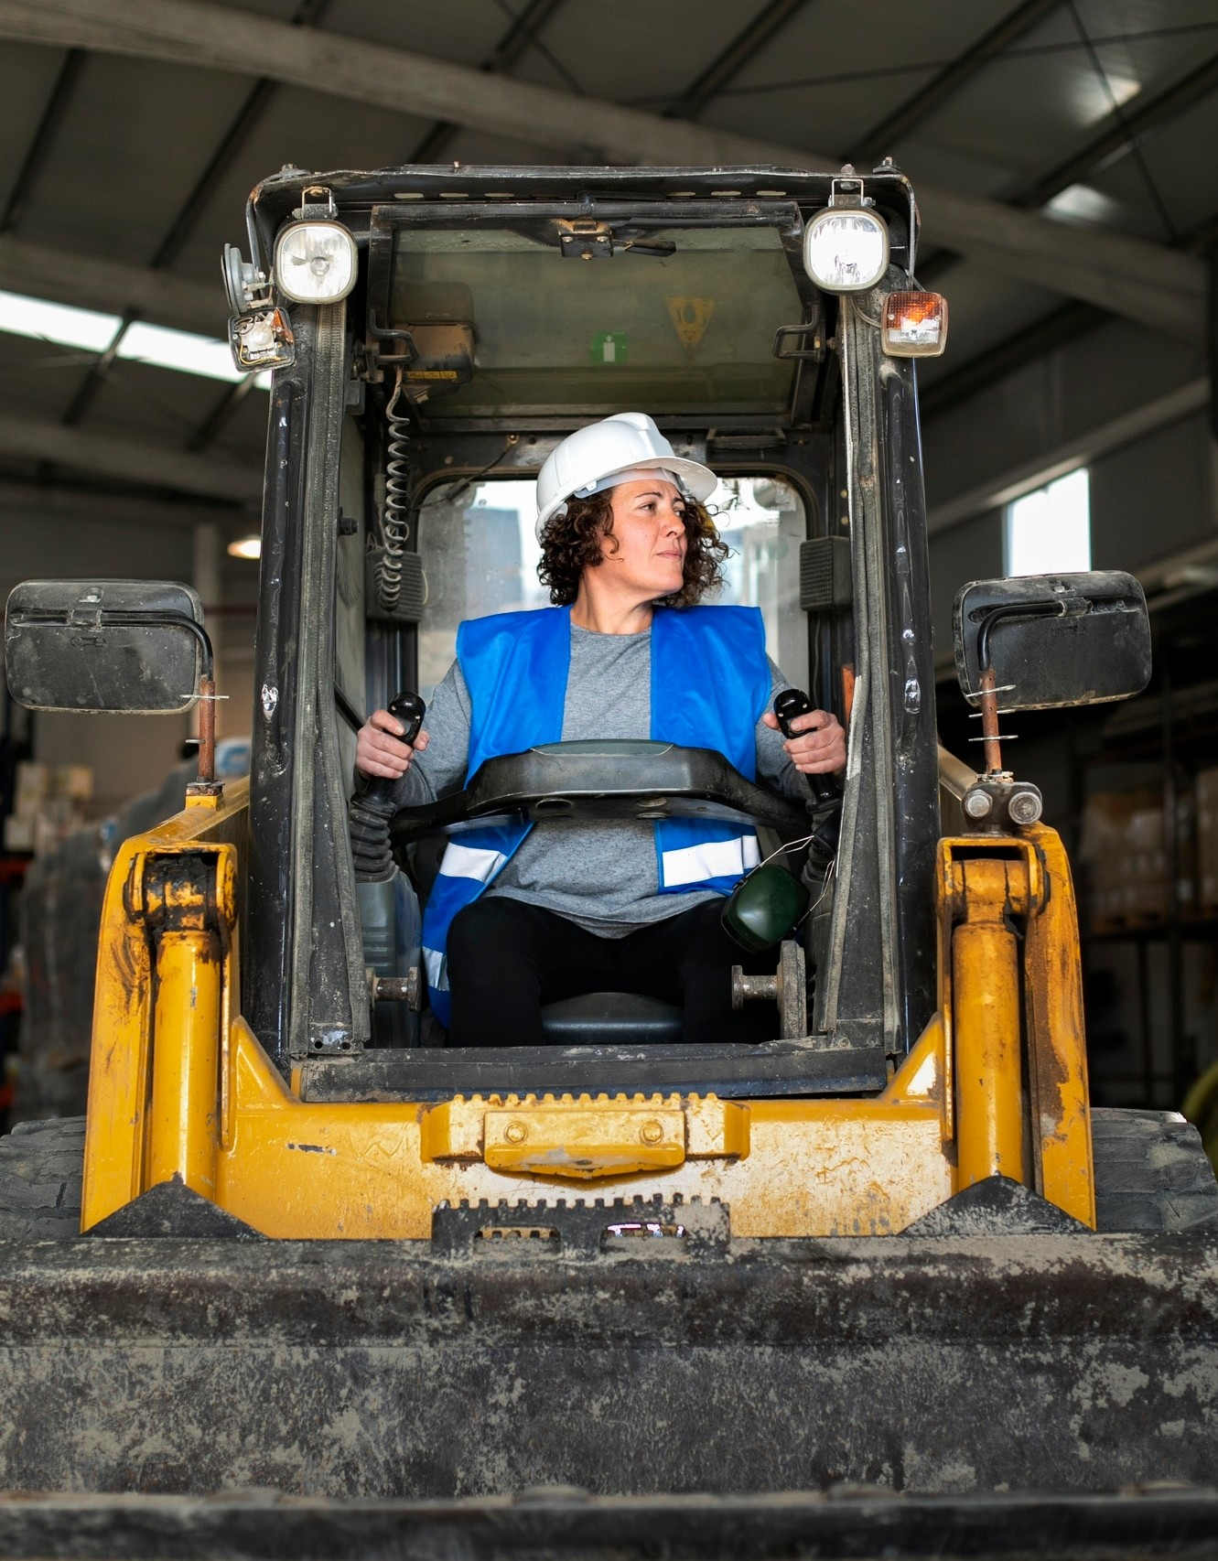
Challenges faced, and future plans
The main challenge during this hackathon was implementing the hardware miniature model due to the components malfunctioning last moment.
Due to the lack of datasets, implementing the perception algorithm will take a lot of time, finding datasets, processing them, testing and training models. Time is the only constraint here.
This project can also be transitioned into self operating mining equipment, which is the long shot goal, hard but not impossible.

Slide 21
Thanks!

